Slide 1

User Function Design
From User Function group

Slide 2

PART
1
Architecture

Slide 3
Architecture Diagram
Data

Slide 4
PART
2
Component

Slide 5
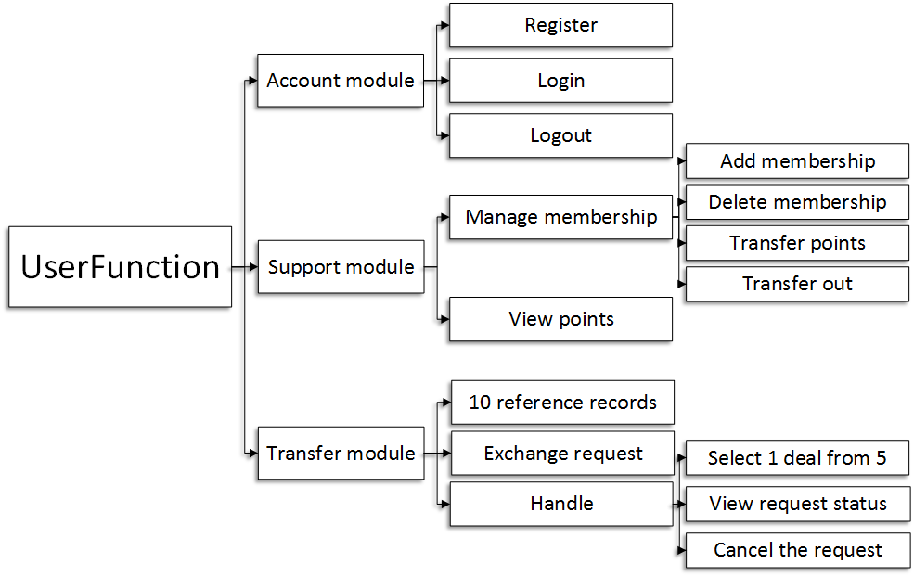
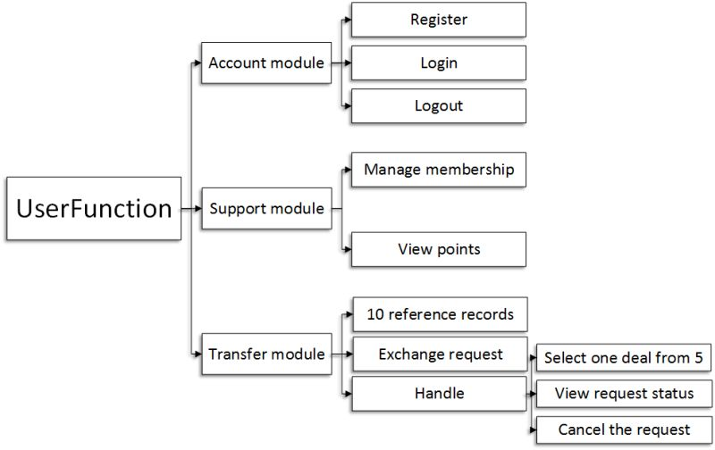
Module Design
10 reference records

Slide 6
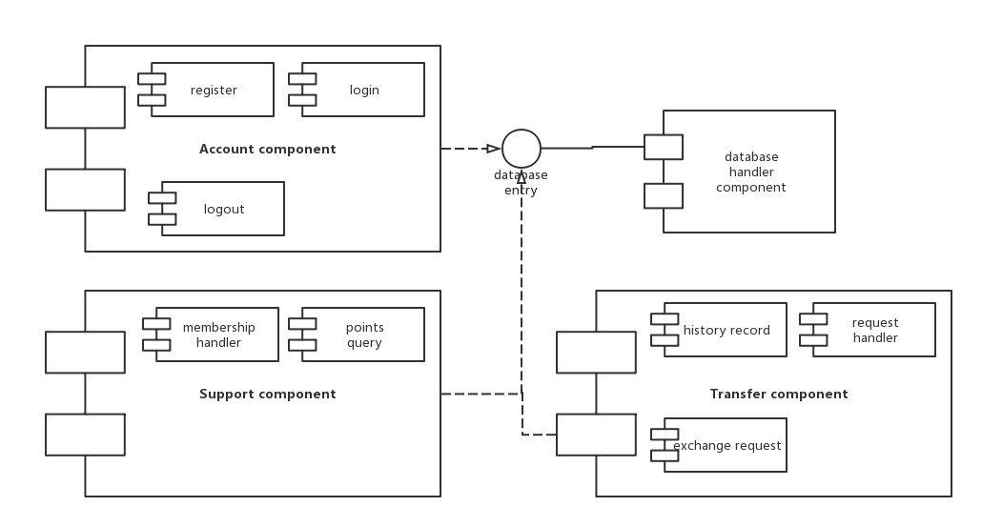
Component Design

Slide 7
PART
3
Interface

Slide 8
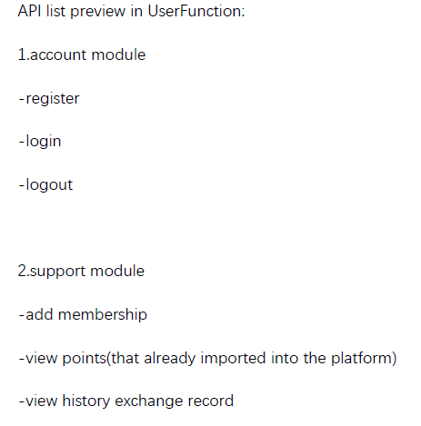
API List

Slide 9
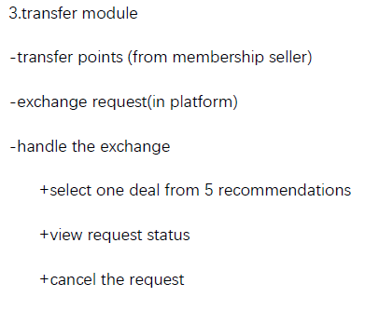
API List

Slide 10
PART
4
Database

Slide 11
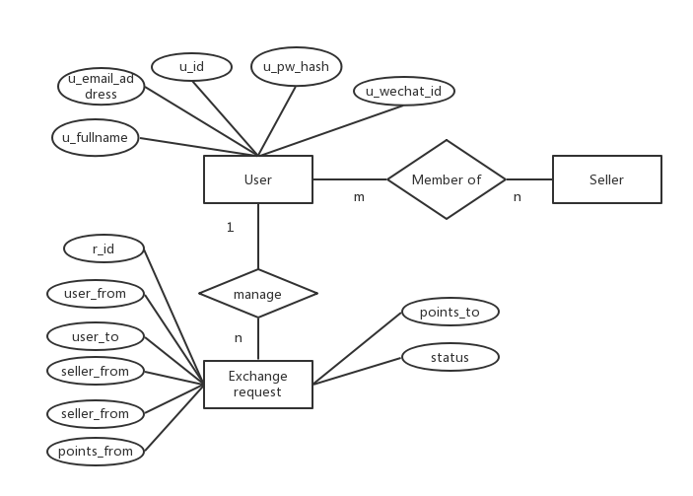
Entity Relation Diagram

Slide 12
User
U_id | int
U_name | Varchar
U_wechat_id | Varchar
U_email_addres | Varchar
U_pw_hash | Varchar
U_fullname | varchar | Empty allowed
U_token | varchar | Generated by system

Slide 13
User_to_seller
U_id | int | User_id
S_id | int | Seller_id
Points | Varchar | (have transferred into System)

Slide 14
Exchange_request
r_id | int
User_from | int | U_id in User
User_to | int | U_id in User
Seller_from | int | S_id in Seller
Seller_to | int | S_id in Seller
Points_from | Number | Is there numeric amount?
Points_to | number
status | Varchar/enum

Slide 15
PART
5
Activity Diagram

Slide 16
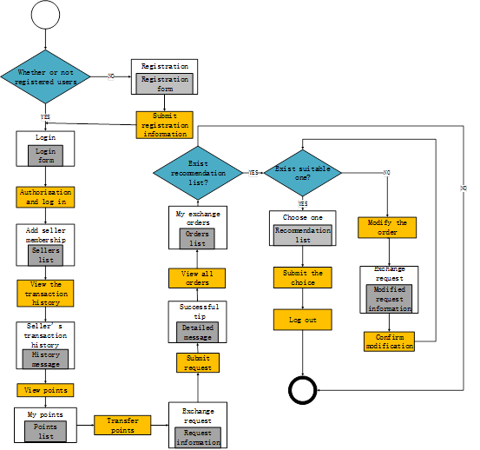
Activity Diagram

Slide 17
PART
6
Sequence Diagram

Slide 18
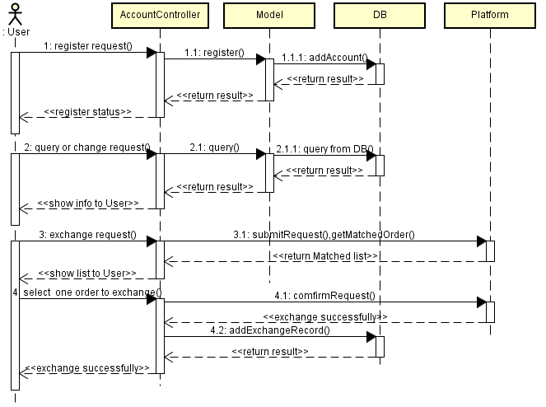
Sequence Diagram

Slide 19
PART
7
Class Diagram

Slide 20
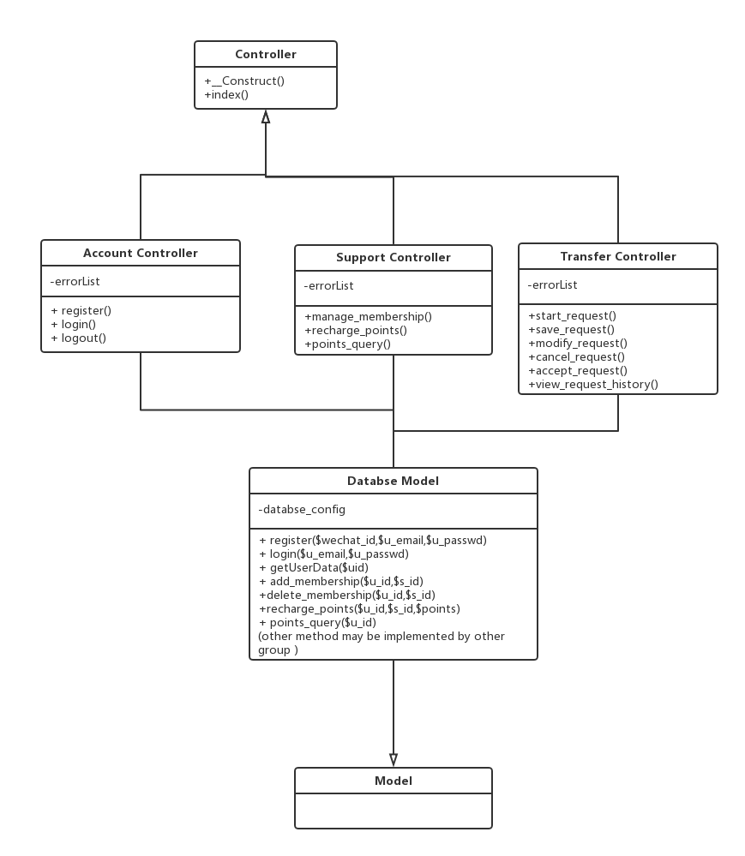
Class Diagram

Slide 21

Thanks

